Slide 1



Slide 2
Team Members
Saurabh Poojary
Sunil Hariharan
Akshay Lakde
Dhawal Charaniya
Vaibhav Rane

Slide 3
Problem Set
To forecast the number of Sales.
To forecast the number of price.
Goal – Forecasting the optimized inventory Strategy.
Target Variable
- Number of Sales
- Price

Slide 4
Data Description
Total of 1529 unique items.
category1, category2 contains missing values and category 3 are binary masked features, ordered masked feature, unordered masked feature.

Slide 5
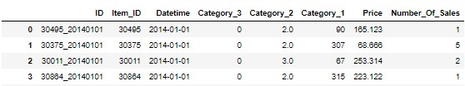
EDA of old Dataset
Old Data set

Slide 6
Feature Selection
For Time series model
Uni-variant analysis used.
For data driven models:
all the time related features from datetime column and done some feature engineering for some extra predicted features

Slide 7
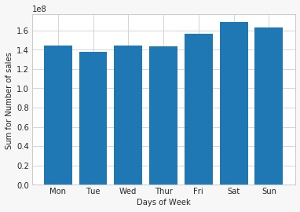
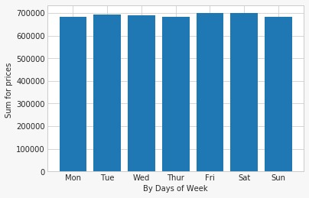
EDA (By Week)
Sum of Number of
Sales
Sum of Price

Slide 8
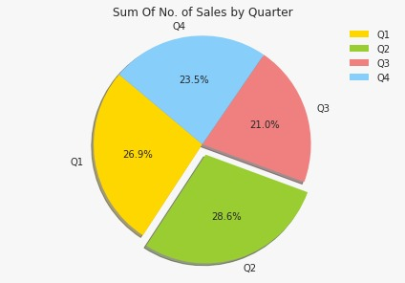
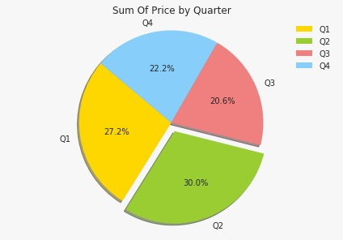
EDA (Quarter of Year)
Sum of Number of Sales
Sum of Price

Slide 9
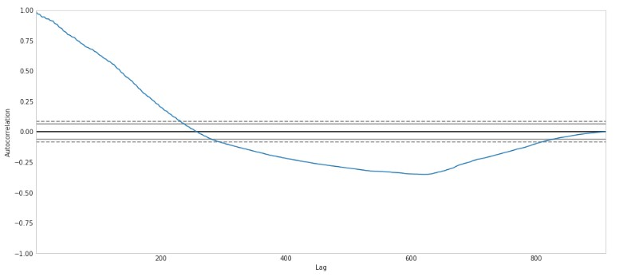
EDA
Auto co related Plot for max Item ID

Slide 10
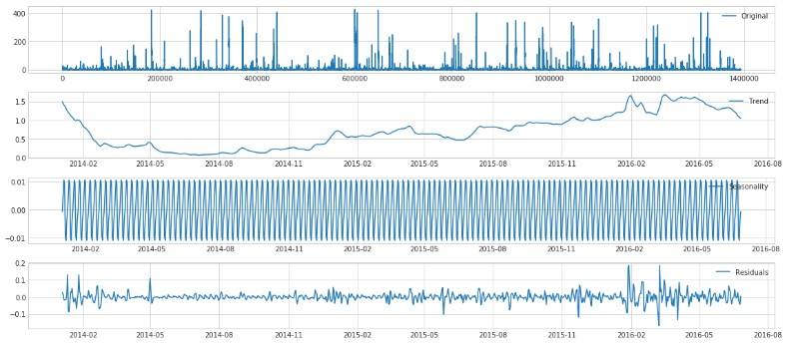
EDA
Decomposition of Price of max Item Id

Slide 11
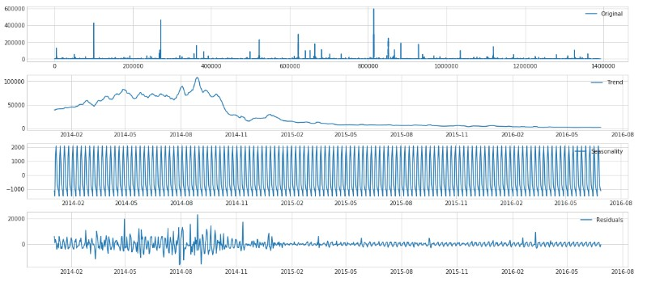
EDA
Decomposition of Sales of max Item ID

Slide 12
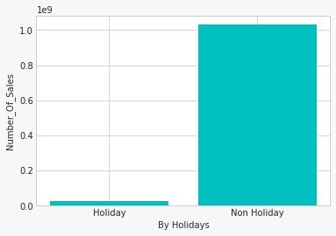
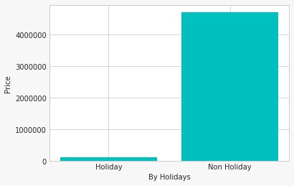
EDA (for Holidays)
Number of Sales on Holidays
Price on Holidays

Slide 13
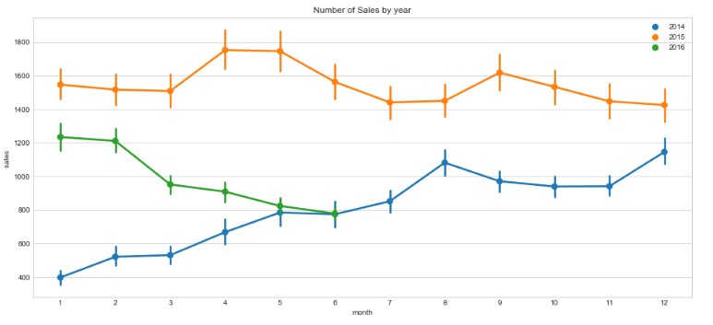
EDA
Line Plot

Slide 14
Data Driven Model (Linear Regression and XGBoost)
The Time based features we used are 10 counts:
- day of week
- holiday
- quarter of year
- day of year
- week of year
- year
- month
- day
- Ismonthend
- Isyearend

Slide 15
Data Driven Model
Feature hashing
- item ID (feature vector of10).
Two new columns
- lag variables of price
- lag variables of number of sales

Slide 16
Linear with Lasso
RMSE for Price: 2.53
RMSE for Number of Sales: 1245
Alpha: 0.1

Slide 17
Linear with Ridge
RMSE for Price: 2.48
RMSE for Number of Sales: 1243
Alpha: 0.1

Slide 18
Data Driven Model for XGBoost
RMSE for price: 2.45
RMSE for number of Sales: 1200
After Hyper parameter Tuning and grid Search and cross validation score.
- RMSE for Price: 2.43
- RMSE for number of Sales:1200

Slide 19
Cross Validation Score
0.9539
0.9357
0.9273

Slide 20
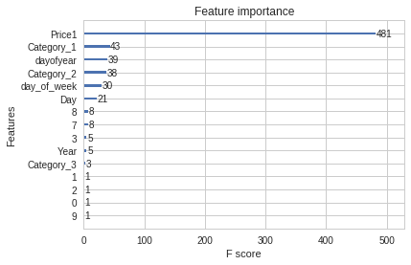
EDA for Data Driven Model

Slide 21
Traditional Methods
Naïve Forecast
- Price RMSE: 4.966
- Volume RMSE: 1490.555
Simple Moving Average
- Price RMSE: 2.646
- Volume RMSE: 28.977
Exponential Moving Average
- Price RMSE: 0.504
- Volume RMSE: 125.192

Slide 22
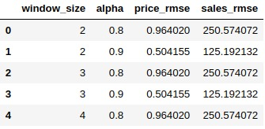
Metrics

Slide 23
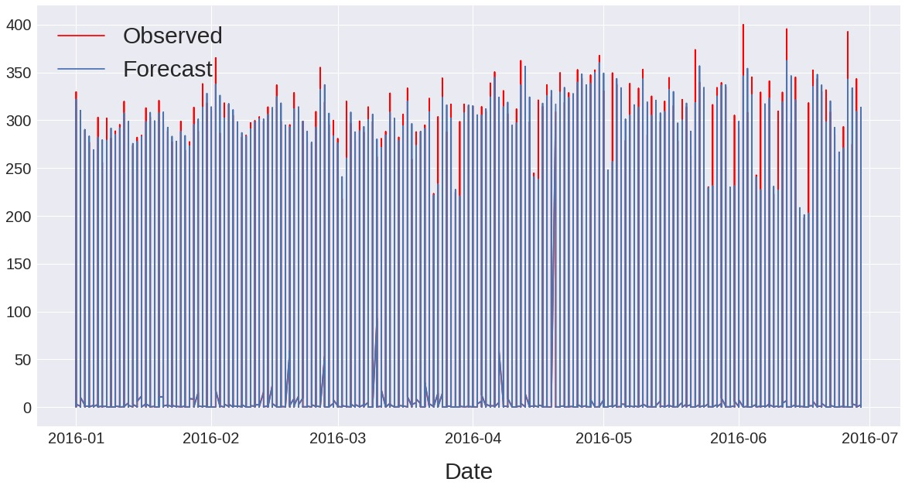
Prediction of Price

Slide 24
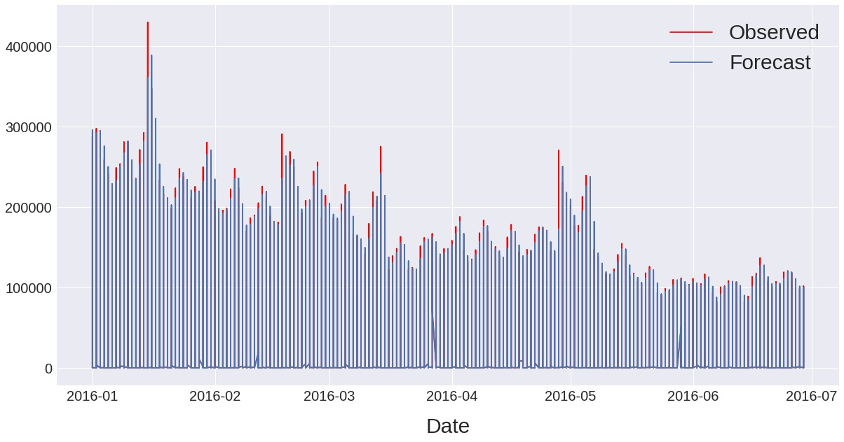
Prediction of Sales

Slide 25
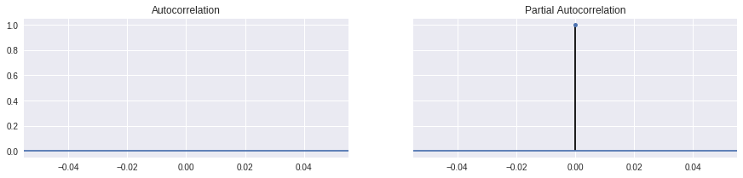
PACF and ACF Plot

Slide 26
Thank You

